Slide 1

The UPIC Audit Landscape
Risk, Enforcement, and Impact
July 10, 2025
2:00 – 3:30 PM EST
Presented by the Regulation, Accreditation, and Payment Practice Group
Notes:
Shareable link: https://educate.americanhealthlaw.org/local/catalog/view/product.php?productid=1461

Slide 2


Today’s Presenters
Jennifer Weaver
Jon Rawlson
Partner
Holland & Knight
Founder and CEO
Armory Hill Advocates

Slide 3
UPIC Audits are Blindsiding Providers and Legal Teams
CMS’ contractors build their cases in silence. Could your clients be next?
Long Cases, No Warning
Provider Bears Burden
Serious Risk for Providers
Pre-audit surveillance
Automated triggers
18+ month process
5-step appeal
Recoupment liability, pre-adjudication
Payment suspensions
Millions in penalties
Law enforcement referral
!
!
!

Slide 4
Most providers do not know they are
under investigation.
Until it is too late.

Slide 5
Poll Question
How well do you know
the UPIC audit process?
Notes:
Question: How much do you feel like know about UPIC audits?
Answers:
A) I’ve managed cases, start to finish.
B) I’ve supported a case or two—enough to know the stakes are high!
C) I know the basics and I’m excited to learn more.
D) UPIC stands for something, right? Please send help. 🫣 (i.e., UPIC audits are new to me.)

Slide 6
Poll Answers
How well do you know
the UPIC audit process?
A) I’ve managed cases, start to finish.
B) I’ve supported a case or two—enough to know the stakes are high!
C) I know the basics and I’m excited to learn more.
D) UPIC stands for something, right? Please send help. 🫣 (i.e., UPIC audits are new to me.)

Slide 7

The UPIC Audit Landscape Webinar
Learning Objectives
Explore UPIC audit trends
and consequences
Analyze compliance
complexities
Identify audit defense strategies
Apply case insights to strengthen audit readiness

Slide 8


Providers Need Expert UPIC Audit Support
Jennifer Weaver
Partner | Holland & Knight
Jon Rawlson
CEO| Armory Hill Advocates
Combined Expertise
100+ UPIC audit cases (and growing)
$150M+ in overpayments overturned
Segment specialization: Home healthcare, hospice, behavioral healthcare, wound care, pain management, physician practices and providers,
clinical laboratories

Slide 9

CMS UPIC Audits: Overview
What are they? When can they occur? What’s at stake?

Slide 10
About the UPIC Audit
UPIC = Unified Program Integrity Contractors hired by CMS to investigate FWA for Medicare and Medicaid programs
Specialized focus: Complex care, high-dollar claims, ownership changes raise red flags
At-Risk Segments
Clinical laboratories
Behavioral health providers
Wound care specialists
Hospice providers
Home health providers

Slide 11
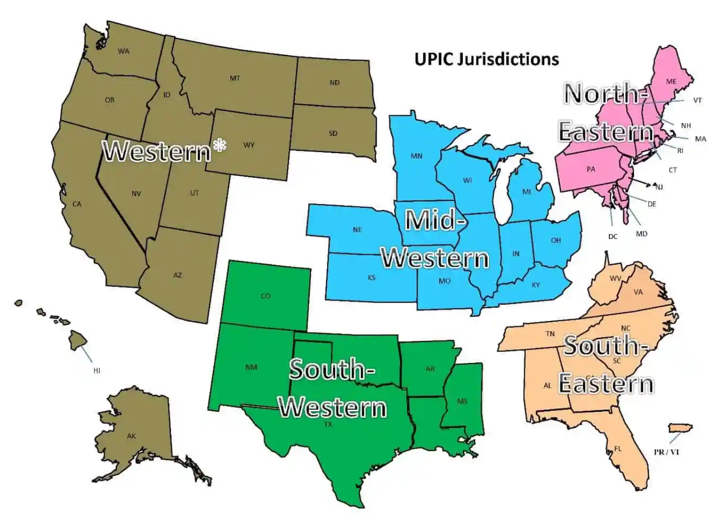
5 UPIC Jurisdictions, 3 Contractors
UPIC Contractors (by region)
Western and Southwestern: Qlarant
Midwestern: CoventBridge Group
Southeastern and Northeastern: SafeGuard Services, LLC (SGS)

Slide 12
UPIC Audits Are Anything but Routine
Initiation
90% triggered by claims data mining tools
Cases built based on suspected fraud
Discovery
Providers notified only after CMS referral
Contracted auditors handling specialized cases
Adjudication
Risk of pre-payment review, suspensions, exclusions, overpayment recoveries
5-step appeal
process

Slide 13
Extrapolation
UPICs use statistical sampling on a small universe of claims to extract multimillion dollar overpayments.
Extrapolated overpayment referred to the MAC for recoupment
Findings may be referred to OIG directly, without the provider’s knowledge

Slide 14
Concerns With UPICs
Deficient auditor qualifications
  Auditors not required to have any medical background or training
  Medical necessity determinations by auditors not reviewed by medical professionals
UPICs can request unlimited records
Unreasonable denial rates
Delays in completing audits (6-18 months)

Slide 15
Redetermination
30-day deadline to stay recoupment.
The Medicare Appeals Process
Reconsideration (QIC)
60-day deadline to stay recoupment.
ALJ hearing
No recoupment stay
No new evidence absent good cause
Steps
Medicare Appeals Council
30-day deadline to stay recoupment.
Federal District Court

Slide 16
Extrapolation through statisticians
The Medicare Appeals Process
Medical necessity through clinical experts
Staving off recoupment during first two appeals levels
Potential
Barriers
ALJ hearing
Pre- and post-hearing briefing
Effective preparation of witnesses

Slide 17
Case Studies
What does a UPIC audit look like?

Slide 18

Behavioral Health Case Study
$21M Overpayment
Inpatient psych hospital specializing in substance use disorder (SUD) treatment hit with UPIC audit by CoventBridge during the height of the COVID pandemic.

Slide 19
Behavioral Health Case Study
98% error rate extrapolated over 4+ years → $21M overpayment
Auditor lacked behavioral health expertise → faulty assumption that inpatient SUD treatment is never medically necessary
3 appeal rounds → ALJ decision reducing overpayment to $76k

Slide 20

Physician Practice Management (Dermatology) Case Study
Targeted Scrutiny for Emerging Treatments
MSO model for providing groundbreaking skin cancer treatment in dermatology practices nationwide.

Slide 21
Physician Practice Management (Dermatology) Case Study
Dozens of UPICs hitting practices across the country
Denied payment on grounds that treatment was investigational/experimental
Aggressively appealed to produce favorable decisions; part of larger CMS strategy

Slide 22

Home Health Case Study
Overturned Payment Suspension
Home health provider hit with Medicare payment suspension following UPIC audit by SafeGuard.

Slide 23
Home Health Case Study
Auditors interviewed Alzheimer’s patients who couldn’t recall home visits
Medicare payment suspended based on assumption services weren’t delivered
Suspension and associated overpayment terminated in <2 months after lobbying

Slide 24
Challenges and Opportunities
How can we advocate for UPIC audit improvements together

Slide 25
From the Hill: The Latest Enforcement Trends to Watch
UPIC audits becoming more frequent and complex
Congressional interest in greater transparency, UPIC MAC reforms
Efforts to streamline coverage determinations and audit triggers
Changes to demand letters → certified mail
As the new administration settles in, CMS will continue to look for innovative ways to prevent fraud, waste, and abuse.
Notes:
UPIC MAC REFORMS – CONGRESS HAS HAD AN ONGOING INTEREST (SENATE FIN COMMITTEE IN OVERSIGHT FOR UPICS AND MACS…AND MAKING IT MORE TRANSPARENT…SO…CMS JUST RECENTLY PUT A REQUEST TO PROVIDERS FOR IDEAS ON HOW THEY CAN REFORM DIFFERENT ASPECTS OF THE MEDICARE PROCESS (NOT JUST CPI /PROG INTEGRITY, BUT RELATED TO MACS)…UPICS AND MACS HAVE TIRED TO LIMIT COVERAGE DETERMINATION FOR CERTAIN CLASSES OF HC PROVIDEERS…THEN TRIGGERS UPIC AUDITS…WE HAVE BEEN WORKING WITH CMS TO STREAMLINE THAT PROCESS…

Slide 26
Transparency
Most providers audited will never see the data which led to their audit.
Lobbying for UPIC
Audit Improvements
Provider Relations
Although UPIC’s are required by CMS to have a provider relations dept, rarely do they respond to provider inquiries.
Lack of Medical/Clinical Expertise
CMS does not require UPIC’s medical reviews to have clinical depth.

Slide 27
Questions?
Notes:
Do not delete

Slide 28
Thank you! We’d love to hear from you.
Jennifer Weaver
Jon Rawlson
Founder, CEO
Armory Hill
Advocates
Partner
Holland & Knight
jennifer.weaver@hklaw.com
jon@armoryhilladvocates.com
615.850.8116
321.436.0836

Slide 29
Thank you!
Notes:
Do not delete

Slide 30
Educating and Connecting the Health Law Community
americanhealthlaw.org
Notes:
Do not delete

Slide 31

  © 2025 is published by the American Health Law Association. All rights reserved. No part of this publication may be reproduced in any form except by prior written permission from the publisher. Printed in the United States of America.
  Any views or advice offered in this publication are those of its authors and should not be construed as the position of the American Health Law Association.
  “This publication is designed to provide accurate and authoritative information in regard to the subject matter covered. It is provided with the understanding that the publisher is not engaged in rendering legal or other professional services. If legal advice or other expert assistance is required, the services of a competent professional person should be sought” —from a declaration of the American Bar Association.
Notes:
Do not delete

